Slide 1

Play store app reviwew analysis
Capstone project 1

Slide 2
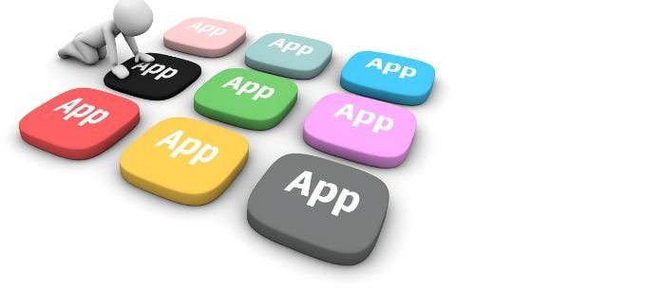

Slide 3
Team members
Deepankar singh
Dhruv Dubey
Sanket Kamble
Pratikisha Chimankar
Komal Sursawant

Slide 4
Contents
Introduction
Objectives
Problem statements
Description of data
Cleaning of data
Data analysis and visualization
conclusion

Slide 5
Introduction
Google play store was launched on March 6, 2012,bringing togther Android Market marketing a shift in the Google’s digital distribution strategy
As we know that google play store apps is the biggest market for Android app because of more than 5 millions application with more than 3 billion active users in more than 190 countries.

Slide 6
Objectives
Find the most popular and trending apps
Analyse the Reviews, Rating, Sentiments of people towards various apps .
Find how small changes or update impacts on app performance
Understanding Consumer behaviour and demand ,how they react with different genres of Google Playstore Apps

Slide 7
Problem statements
* What are the top categories on play store?
* Importance of rating of application?
* Most percentage of content on play store are in which category?
* Which category has the most number of installation?
* Check correlation
* How are reviews and rating co-related?
* Mostly used words on play store reviews?
* Relationship between content Rating in Free and paid apps?
* What are the sentiments across database?
* How size impacts on installation of apps?

Slide 8
Description of dataset
Play store data:-
App: name of the application
Category: category of application
Rating : rating given to the application
Reviews: Number of reviews given to the Application
Size : Size of the application
Installs: Number of downloads of the Applications
Type : Free or Paid
Price : Price of the applications

Slide 9
Description of Dataset
Content Rating : it is related to the age of consumer
Genres : Types of Genre of the Application on the play store

Slide 10
2.User Reviews data:
App: An app name
Sentiments: Sentiment given to an apps by consumer
Sentiment polarity: The polarity of sentiments measures how negative and positive the context is.
Sentiment subjectivity: The subjectivity of sentiment is how likely that sentiment is to be based on data or factual information.

Slide 11
Data cleaning
This is the most important part of project .Validate and cleanse the data is the essential for eliminating inaccurate data and completing gaps. Here are several key duties
deleting unnecessary data completing blank values.
For a given application, a dataset might contain duplicate values we need to remove it.

Slide 12
Data cleaning
Data cleaning step:
Removing unwanted value: Removal of duplicate / invalid values.
Handling missing values: dealing with missing values in our data base.
Filtering Unwanted outliers: Removing incorrect or unwanted outliers.

Slide 13
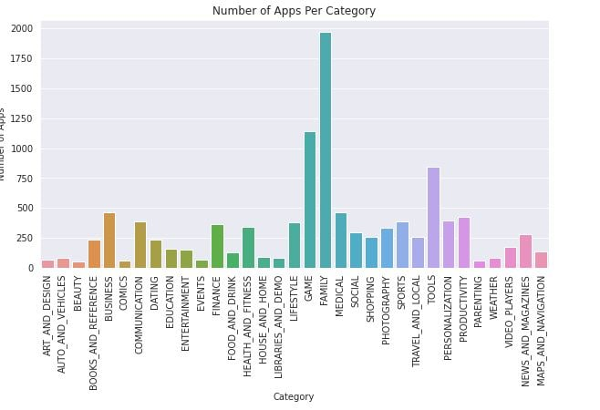
Data Analysis & visualization Height number of apps in different category
From the above graph , we can conclude that Family category has highest number of apps in playstore.
Also top 5 category, which has the large number of apps in play store are Family , Game ,Tools , Business, Medical
Family which category has maximum apps in play store more than 1950

Slide 14
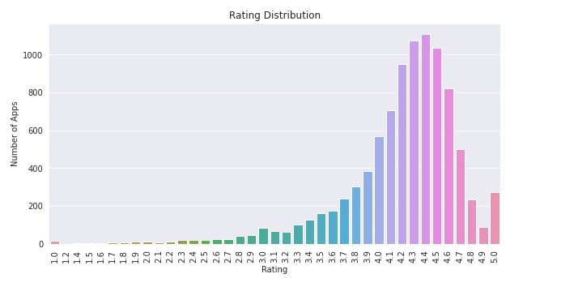
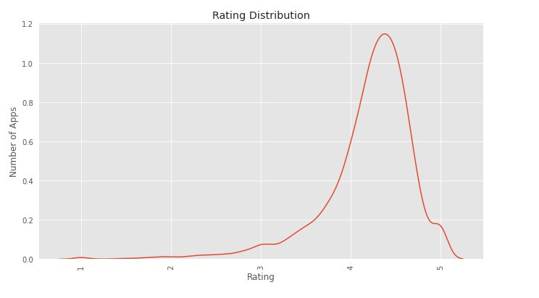
Data Analysis & visualization rating distribution of apps installed on playstore.
As we can see clearly from above bar graph that approx more than 1100 apps have a 4.5 rating. and
According to the below diagram most of the apps is highly rated and less number of apps is low rated . 4.4 is highest number of apps rating

Slide 15
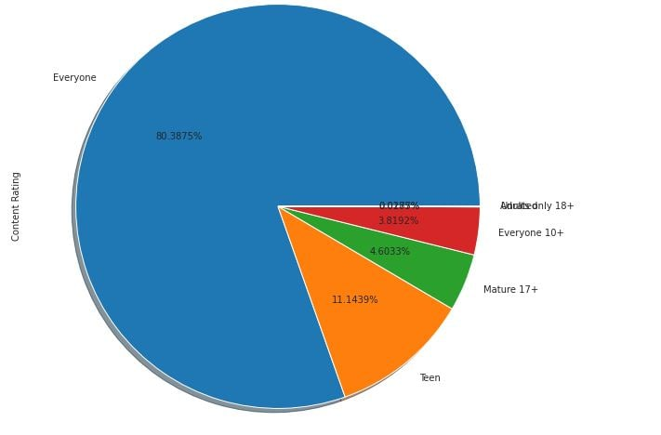
Data Analysis & visualization mostly percentage of content on playstore
From the above pie chart we can conclude that most of the apps uploaded on play store is for every age group with 80%(approx) ,followed by Teen, mature17+,etc

Slide 16
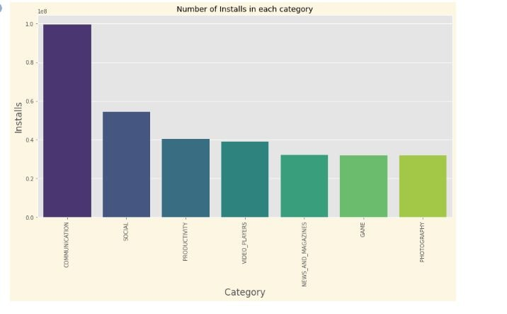
Data Analysis & visualization Height number of Install by consumer in each category
From the above graph we can conclude that a large number of installation is done by consumer in communication category ,followed by social , productivity , etc.
This means that most of the consumer likes the communication apps so, Developer needs to make more apps in this domain.

Slide 17
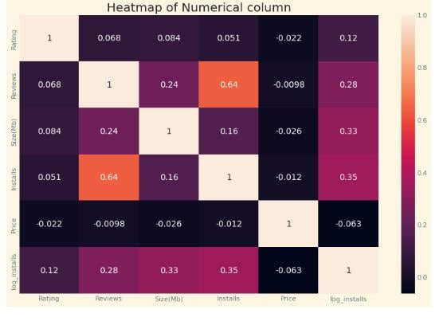
Data Analysis & visualization
There is a strong positive correlation between the Reviews and Installation
The price is negatively correlated with Rating , Reviews, and Installs.

Slide 18
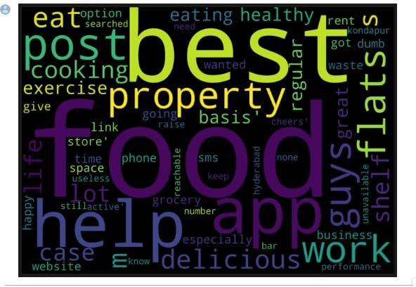
Data Analysis & visualization Mostly used words on playstore reviews
Here ,food, best, app, help, work words are used most of the times by the consumer in reviews.
So,we can coclude that most of consumer like food domain apps therefore if develpoper works in this domain then there is a high chances that apps will be downloaded more.

Slide 19
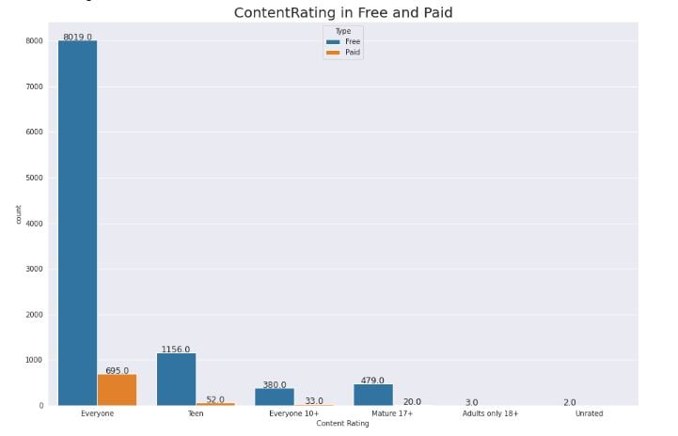
Data Analysis & visualization content rating in free and paid
From this we can conclude that ,most of the consumers are giving good rating to free apps that are present in every category than paid apps.
Every category has maximum number of free apps as compared to paid ones.

Slide 20
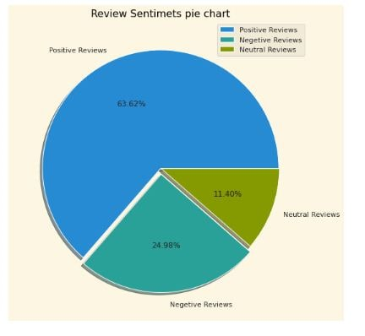
Data Analysis & visualization overall percentage of review sentiments
Most of the sentimental reviews that are given by the users are positive it is around 63.62%.
negative sentimental review percentage is only 24.98%.
This mean developer had to do their hardwork to change this negative sentiments into positive or neutral.

Slide 21
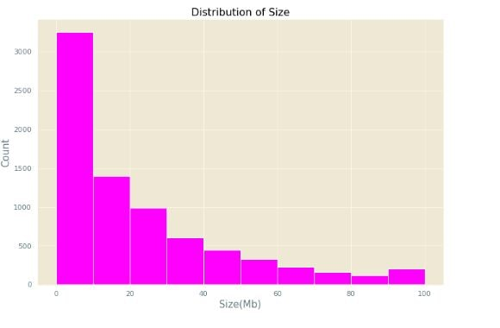
Data Analysis & visualization size of most of the apps installed on playstore
Here, we can say that high number of apps which are installed on playstore are between 0 to 20 Mb size
This means that if the size of apps is less than 20 MB then there is very high chances of downloading that app.

Slide 22
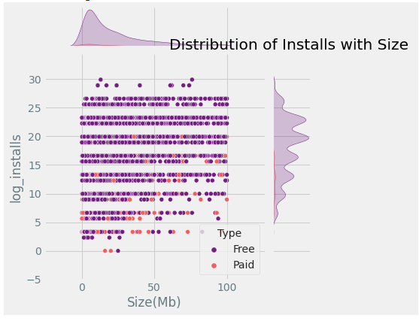
Data Analysis & visualization Distribution of Installs with Size
Above plot clearly indicates that size of apps have direct impact on no. of installation. Apps bigger in size are less installed.

Slide 23
conclusion
Percentage of free apps is higher than paid apps
Percentage of apps uploaded on playstore , in family category is higher than any other category.
There is a strong positive correlation between the Reviews and Installation
The apps whose size is less than 20 MB has a high chance of downloading that apps by consumer.
Price is negatively correlated with the rating, reviews and installation.

Slide 24
Challenges Faced
Huge chunk of data was to be handled on our first project when we have not any experience or do not know how to handled ,where to start,where to end.
Computation time

Slide 25

Yayyy!!! This is the end of our story. Hope you enjoyed this journey. In this, we have seen How every feature has a unique impact on the story .!!!

